Slide 1
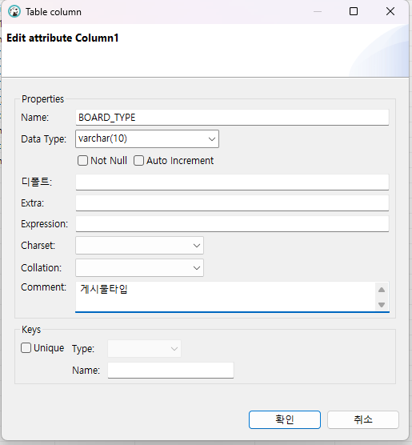
디비버로 BOARD_TYPE 추가
ALTER TABLE board ADD BOARD_TYPE varchar(10) NULL COMMENT '게시물타입';
ALTER TABLE board CHANGE BOARD_TYPE BOARD_TYPE varchar(10) NULL COMMENT '게시물타입' AFTER BOARD_ID;
UPDATE BOARD SET
BOARD_TYPE = 'NORMAL'

Slide 2
context-properties.xml
<entry key="photoThumbWidth" value="200"/>
<entry key="photoThumbHeight" value="140"/>
<entry key="imagePageUnit" value="12"/>
<entry key="imagePageSize" value="10"/>

Slide 3
pom
<!-- 썸네일 -->
<dependency>
<groupId>net.coobird</groupId>
<artifactId>thumbnailator</artifactId>
<version>0.4.2</version>
</dependency>

Slide 4

EgovImageProcessController
위에 추가 후
/cmm/fms/getThumbImage.do 어노테이션 관련 추가

Slide 5
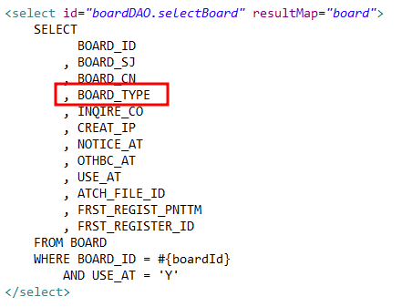
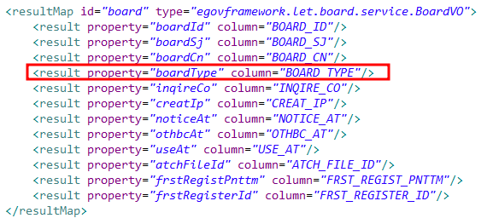
Board_SQL
, (SELECT
CONCAT(X.STRE_FILE_NM, '.', X.FILE_EXTSN)
FROM LETTNFILEDETAIL X
WHERE X.ATCH_FILE_ID = A.ATCH_FILE_ID
AND UPPER(FILE_EXTSN) IN ('GIF','JPG','JPEG','BMP','PNG')
ORDER BY FILE_SN
LIMIT 1
) AS ATCH_FILE_NM

Slide 6
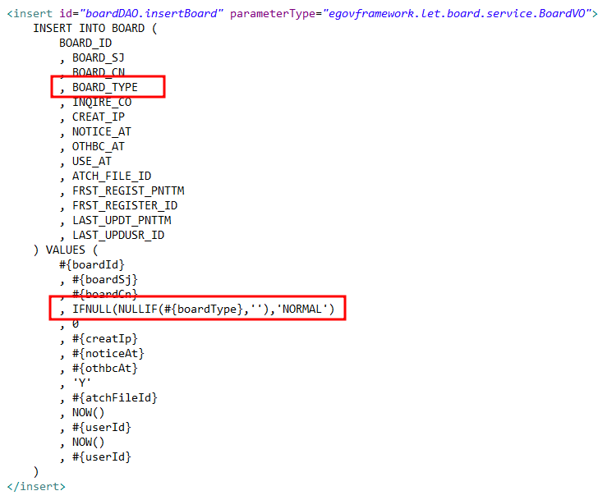
Board_SQL

Slide 7


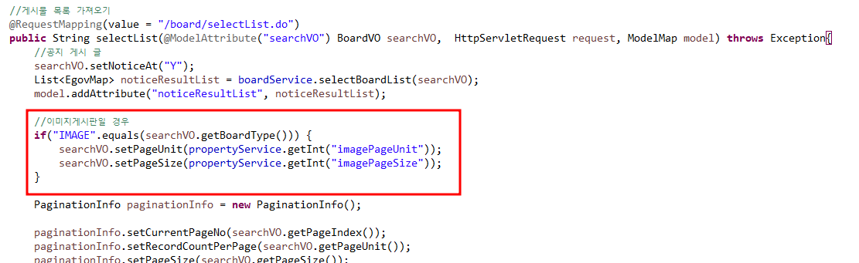
BoardVO
BoardController

Slide 8
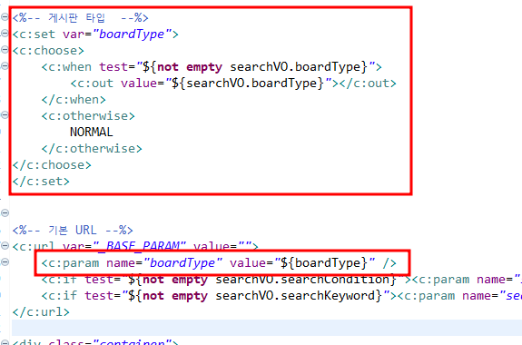
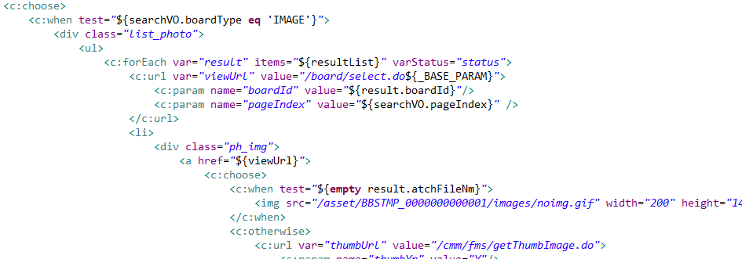
BoardSelectList
기존 게시판 c:choose로 변경

Slide 9
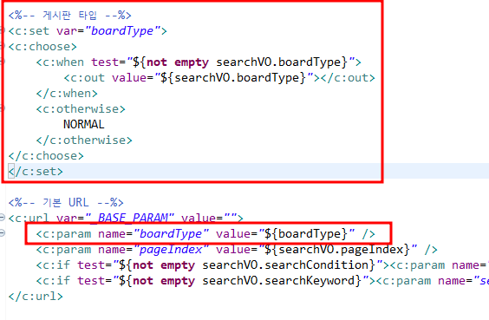
BoardSelect

Slide 10
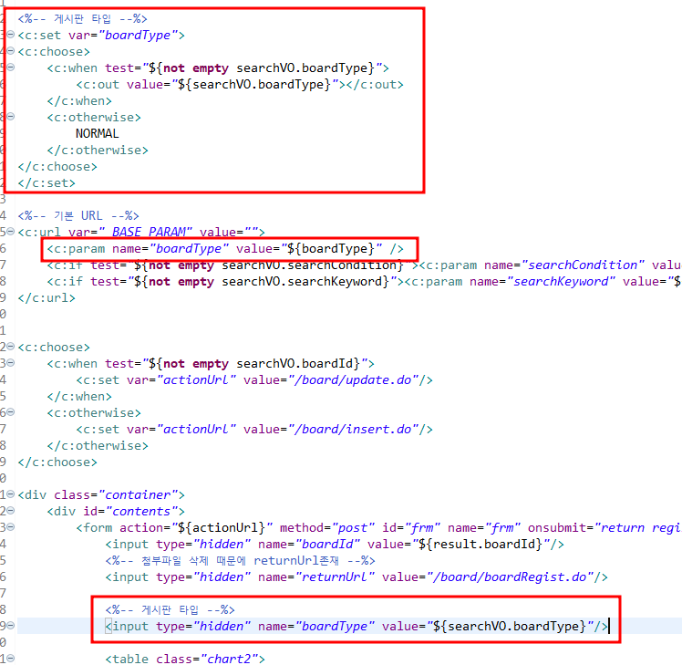
BoardRegist

